Slide 1
Summary: Chapter 8-9: Classification
Concepts, supervised learning, and applications
Classification models
Decision Tree (ID3, C4.5, CART)
Information gain, gain ratio, gini index
Naïve Bayes
Support Vector Machines
Artificial Neural Networks, Deep Neural Networks
Classification evaluation
Accuracy, precision, recall, F1, ROC curve, P@K…

Slide 2
Course Project
Data objects: papers, authors …
Labels: conferences
Features: paper’s terms, author’s paper’s terms …
Models: decision trees (ID3, C4.5, CART), naïve bayes, support vector machines (LinearSVM, KernelSVM), neural networks

Slide 3
NIPS Challenges 2017
https://www.kaggle.com/c/msk-redefining-cancer-treatment
Data objects?
Labels?
Features?
Models?

Slide 4
Schedule
Nov. 9: HW4 due, HW5 out
Nov. 21: Last lecture of new content
Thanksgiving break
Nov. 28: Course review, HW5 due
Nov. 30: Course review, Project due
Early project presentations (+10*25% points)
Let me know before/at Nov. 28’s class (email).
Submission! You can update till Final exam (Nov. 12)
Dec. 5 and Dec. 7: Project presentations

Slide 5
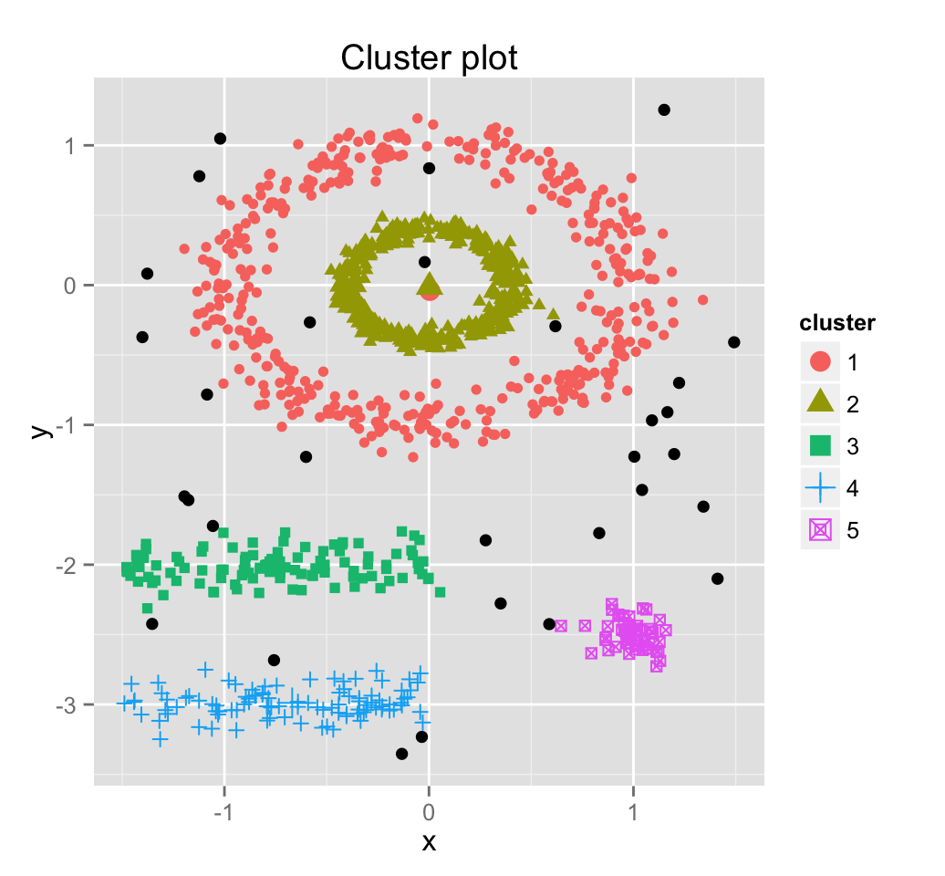
Chapter 10. Cluster Analysis: Concepts
Meng Jiang
CSE 40647/60647 Data Science Fall 2017
Introduction to Data Mining

Slide 6
Outline
Cluster, Cluster analysis, Applications
“Good” cluster, Quality function, Similarity measure
Considerations for Cluster Analysis, Properties of Clustering
Requirements, Challenges
Typical methodologies

Slide 7
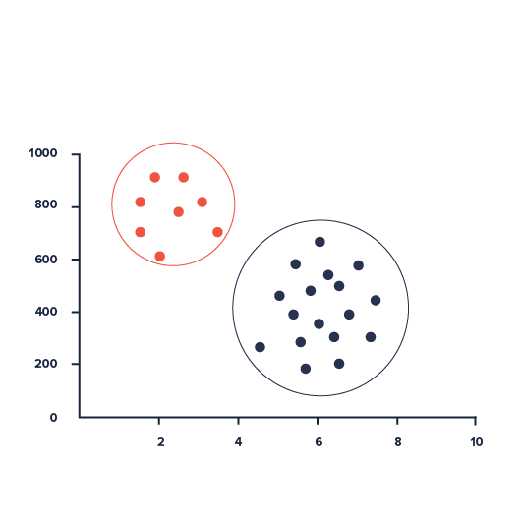
What is Cluster?
A cluster is a collection of data objects which are
Similar (or related) to one another within the same group (i.e., cluster)
Dissimilar (or unrelated) to the objects in other groups (i.e., clusters)

Slide 8
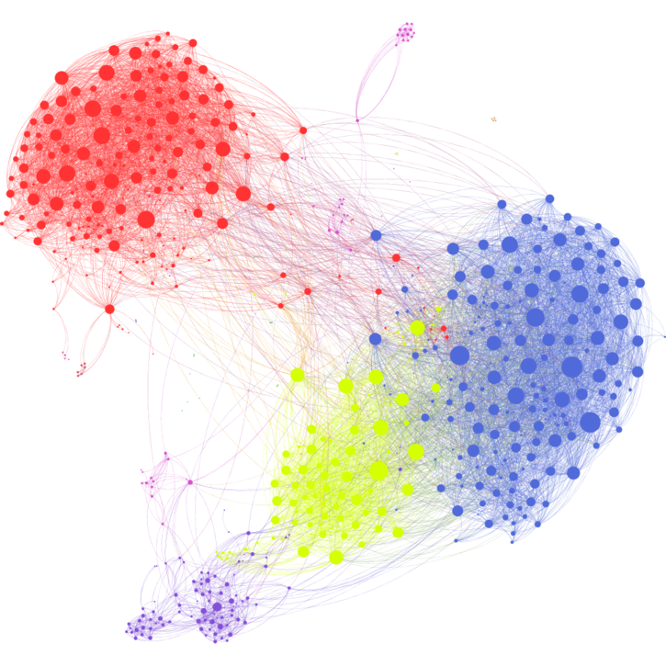
What is Cluster Analysis?
Cluster Analysis (Clustering)
Def. 1. Given a set of data points, partition them into a set of clusters which are as similar as possible.
Def. 2. Grouping data objects based only on information found in the data describing these objects and their relationships (i.e., object/features or node/links).

Slide 9
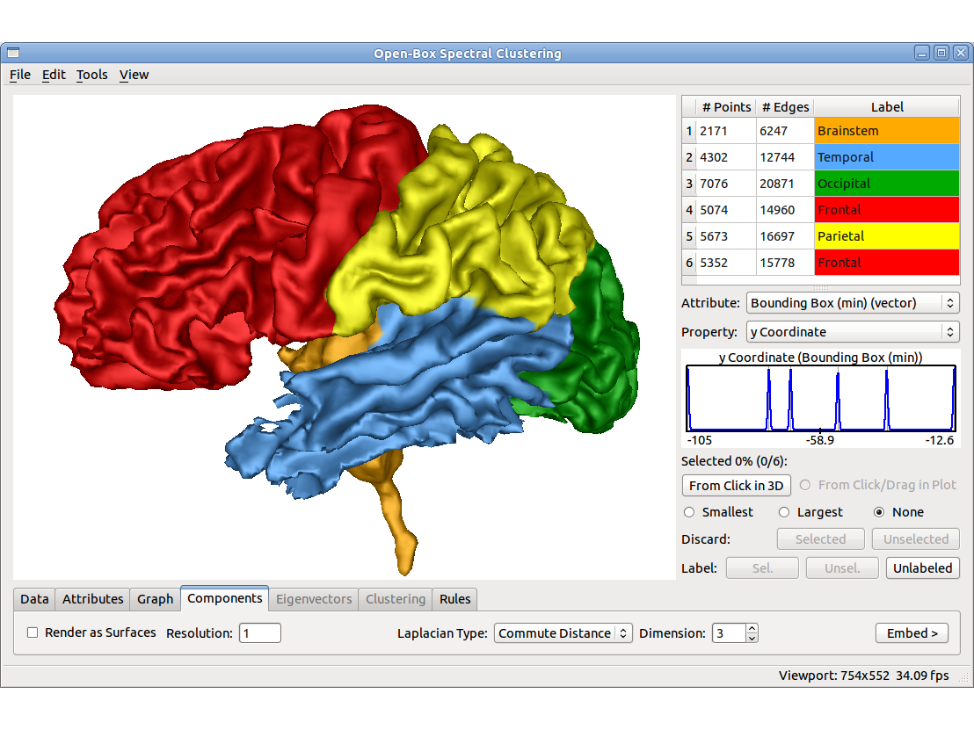
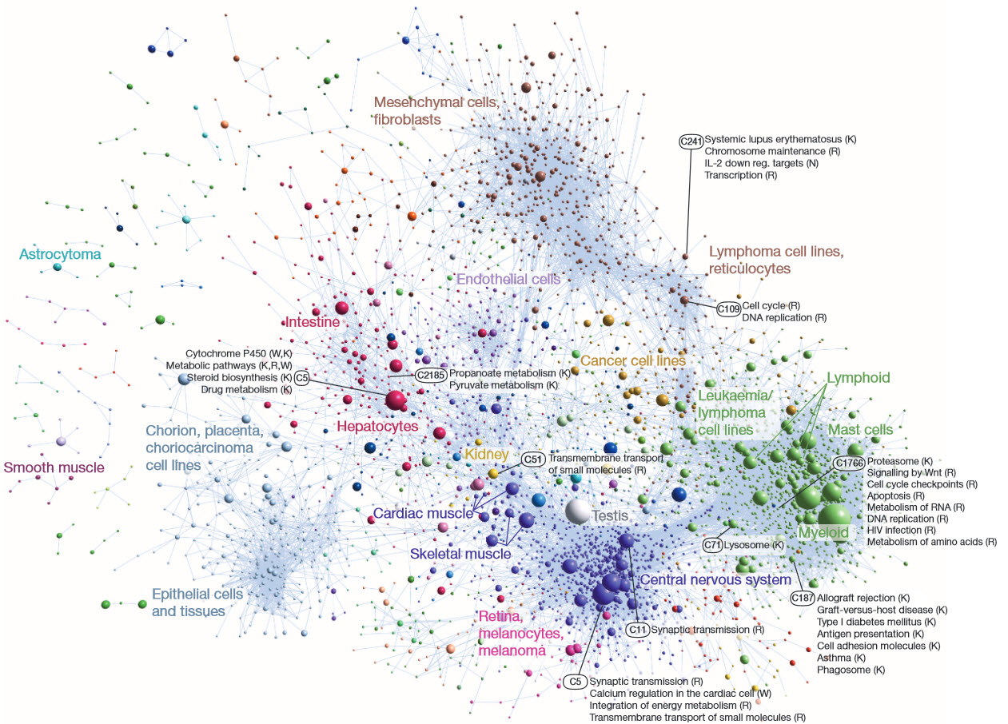
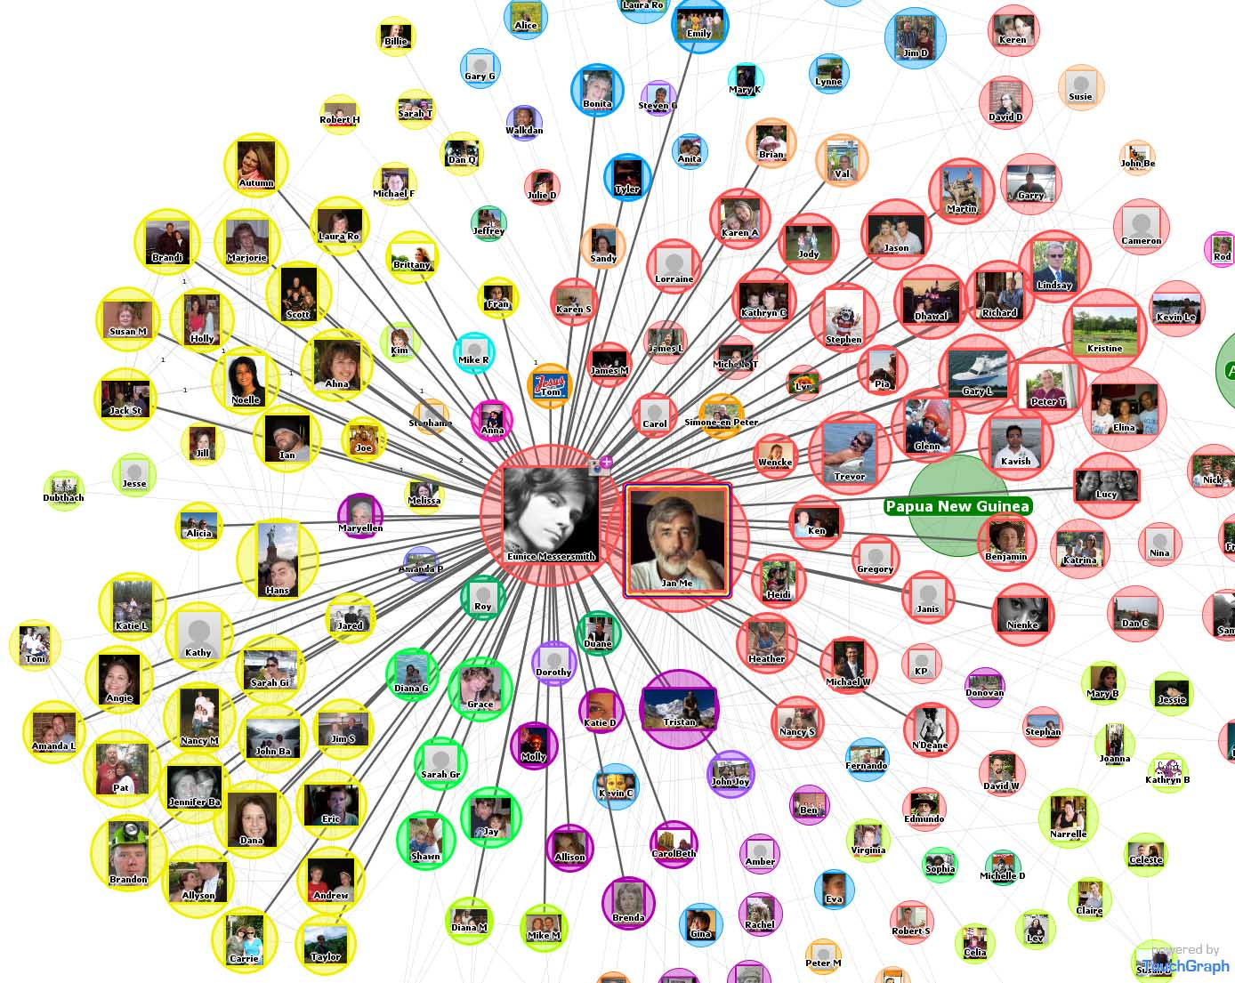
Applications
Typical ways to use/apply cluster analysis
As a stand-alone tool to get insight into data distribution
As a preprocessing/intermediate step for other algorithms

Slide 10
Applications (cont.)
A key intermediate step for other data mining tasks
Generating a compact summary of data for classification, pattern discovery, hypothesis generation and testing, etc.
Outlier detection: Outliers—those “far away” from any cluster
Data summarization, compression, and reduction
Dynamic trend detection
Clustering stream data and detecting trends and patterns
Collaborative filtering, recommendation systems, or customer segmentation
Find like-minded users or similar products
Multimedia data analysis, biological data analysis and social network analysis
Ex. Clustering images or video/audio clips, gene/protein sequences

Slide 11
Formalizing Clustering
Let D denote a dataset containing N observations
D = {x_{i} | i = 1, 2, …, N}
where each x_{i} corresponds to the set of features or explanatory variables – discrete or continuous (categorical or numerical) – of the i-th observation.
Then clustering is the task of learning a mapping of each feature set x into a previously undefined grouping.

Slide 12
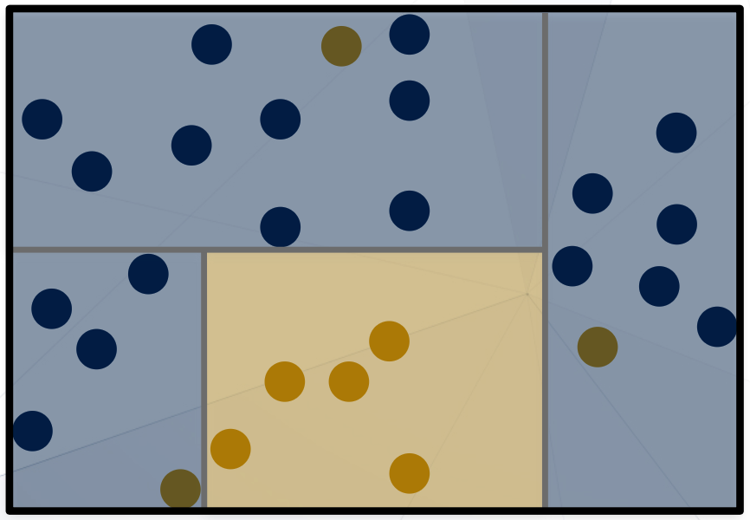
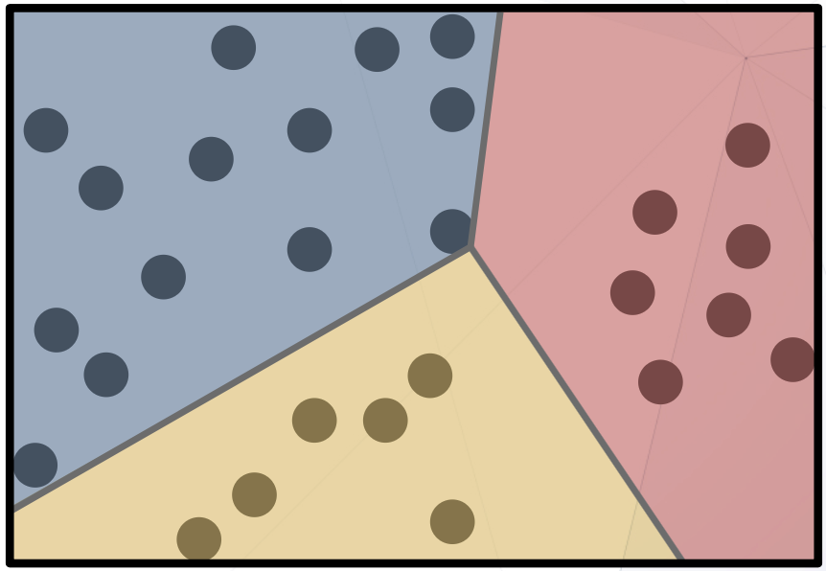
Classification vs. Clustering
Classification:
Predicts instances classes from pre-defined set of classes.
Clustering:
Finds “natural” grouping of instances with out class data.

Slide 13
Unsupervised Learning
Clustering
Input set of features X that can take any set of values (categorical or numerical). The goal is to identify a useful organization or grouping of the instances.
Frequent pattern/association rule mining
Input set of items X. The goal is to discover a set of regularities, frequent itemsets, or rules between occurrences of items in the database or dataset.

Slide 14
Outline
Cluster, Cluster analysis, Applications
“Good” cluster, Quality function, Similarity measure
Considerations for Cluster Analysis, Properties of Clustering
Requirements, Challenges
Typical methodologies

Slide 15
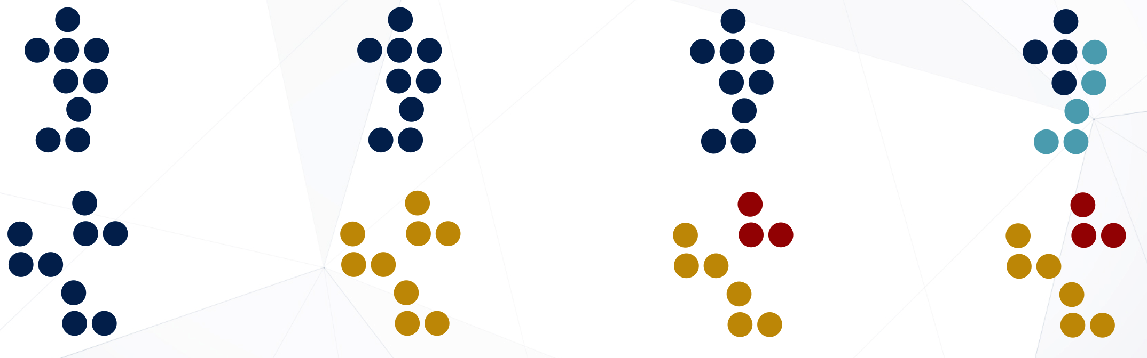
What Defines a Good Cluster?
1-cluster
2-cluster
3-cluster
4-cluster

Slide 16
Good Clusters
A good clustering method will produce high quality clusters which should have
High intra-class similarity: Cohesive within clusters
Low inter-class similarity: Distinctive between clusters
Quality function
There is usually a quality function that measures the “goodness” of a cluster
Depends on similarity measure
It is hard to define “similar enough” or “good enough”
The answer is typically highly subjective
Measured by ability to discover hidden patterns

Slide 17
Similarity and Dissimilarity
There exist many similarity measures and/or functions for different applications
Similarity measure is critical for cluster analysis
Similarity
Measure of “alikeness” of instances
Greater if more alike
Dissimilarity
Measure of “unalikeness” of instances
Lower if more alike
Can be expressed as distance function

Slide 18
Outline
Cluster, Cluster analysis, Applications
“Good” cluster, Quality function, Similarity measure
Considerations for Cluster Analysis, Properties of Clustering
Requirements, Challenges
Typical methodologies

Slide 19
Considerations for Cluster Analysis
Partitioning criteria
Single level vs. hierarchical partitioning (often, multi-level hierarchical partitioning is desirable, e.g., grouping topical terms)

Slide 20
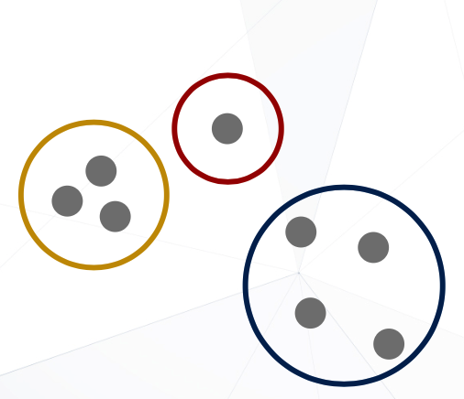
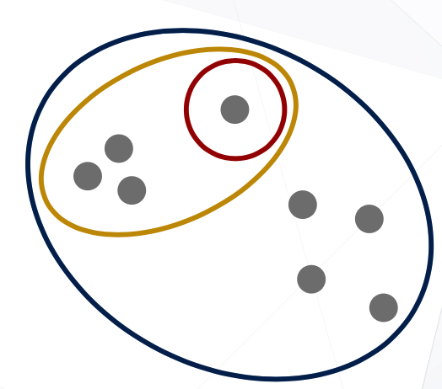
Clustering Property 1
Partitional clustering
Hierarchical clustering

Slide 21
Considerations for Cluster Analysis
Partitioning criteria
Single level vs. hierarchical partitioning (often, multi-level hierarchical partitioning is desirable, e.g., grouping topical terms)
Separation of clusters
Exclusive (e.g., one customer belongs to only one region) vs. non-exclusive (e.g., one document may belong to more than one class)

Slide 22
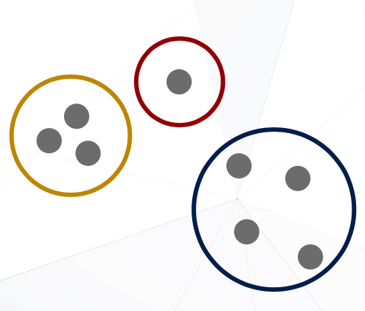
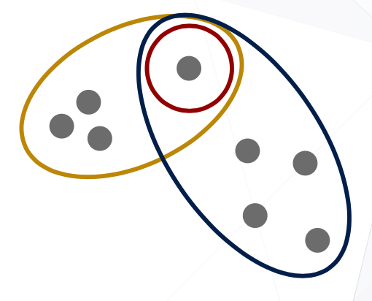
Clustering Property 2
Exclusive clustering
Overlapping clustering

Slide 23
Considerations for Cluster Analysis
Partitioning criteria
Single level vs. hierarchical partitioning (often, multi-level hierarchical partitioning is desirable, e.g., grouping topical terms)
Separation of clusters
Exclusive (e.g., one customer belongs to only one region) vs. non-exclusive (e.g., one document may belong to more than one class)
Outlier vs. Cluster
Complete (e.g., every item has one cluster) vs. partial (e.g., one item may not belong to any cluster)

Slide 24
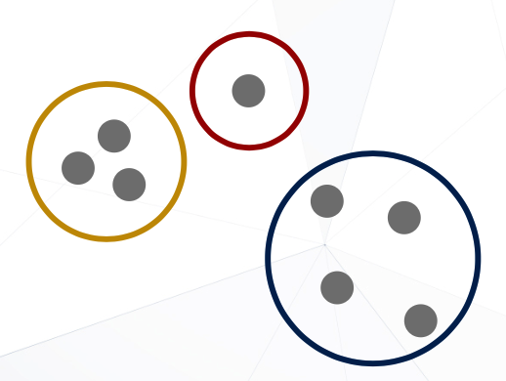
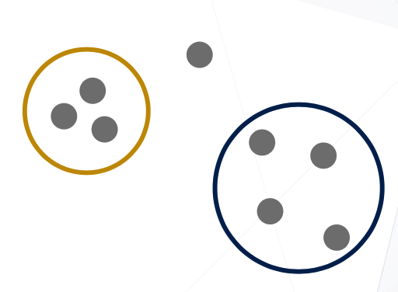
Clustering Property 3
Complete clustering
Partial clustering

Slide 25
Considerations → Cluster Properties
Partitional Clustering vs. Hierarchical Clustering
Exclusive Clustering vs. Overlapping Clustering
Complete Clustering vs. Partial Clustering
Hierarchical clustering
Partitional clustering
Partial clustering
Clustering
Complete clustering
Exclusive clustering
Overlapping clustering

Slide 26
Considerations for Cluster Analysis
Partitioning criteria
Single level vs. hierarchical partitioning (often, multi-level hierarchical partitioning is desirable, e.g., grouping topical terms)
Separation of clusters
Exclusive (e.g., one customer belongs to only one region) vs. non-exclusive (e.g., one document may belong to more than one class)
Outlier vs. Cluster
Similarity measure
Distance-based (e.g., Euclidean, road network, vector) vs. connectivity-based (e.g., density or contiguity)
Clustering space
Full space (often when low dimensional) vs. subspaces (often in high-dimensional clustering)

Slide 27
Outline
Cluster, Cluster analysis, Applications
“Good” cluster, Quality function, Similarity measure
Considerations for Cluster Analysis, Properties of Clustering
Requirements, Challenges
Typical methodologies

Slide 28
Requirements and Challenges
Quality
Ability to deal with different types of attributes: Numerical, categorical, text, multimedia, networks, and mixture of multiple types
Discovery of clusters with arbitrary shape
Ability to deal with noisy data
Q: List some different types of data for cluster analysis?

Slide 29
Clustering Different Types of Data (I)
Numerical data
Most earliest clustering algorithms were designed for numerical data
Categorical data (including binary data)
Discrete data, no natural order (e.g., sex, race, zip-code, and market-basket)
Text data: Popular in social media, Web, and social networks
Features: High-dimensional, sparse, value corresponding to word frequencies
Methods: Topic modeling
Multimedia data: Image, audio, video (e.g., on Flickr, YouTube)
Multi-modal (often combined with text data)
Contextual: Containing both behavioral and contextual attributes
Images: Position of a pixel represents its context, value represents its behavior
Video and music data: Temporal ordering of records represents its meaning

Slide 30
Clustering Different Types of Data (II)
Time-series data: Sensor data, stock markets, temporal tracking, forecasting, etc.
Data are temporally dependent
Time: contextual attribute; data value: behavioral attribute
Correlation-based online analysis (e.g., online clustering of stock to find stock tickers)
Shape-based offline analysis (e.g., cluster ECG based on overall shapes)
Sequence data: Weblogs, biological sequences, system command sequences
Contextual attribute: Placement (rather than time)
Similarity functions: Hamming distance, edit distance, longest common subsequence
Sequence clustering: Suffix tree; generative model (e.g., Hidden Markov Model)
Stream data:
Real-time, evolution and concept drift, single pass algorithm
Create efficient intermediate representation, e.g., micro-clustering

Slide 31
Clustering Different Types of Data (III)
Graphs and homogeneous networks
Every kind of data can be represented as a graph with similarity values as edges
Methods: Generative models; combinatorial algorithms (graph cuts); spectral methods; non-negative matrix factorization methods
Heterogeneous networks
A network consists of multiple typed nodes and edges (e.g., bibliographical data)
Clustering different typed nodes/links together (e.g., NetClus)
Uncertain data: Noise, approximate values, multiple possible values
Incorporation of probabilistic information will improve the quality of clustering
Big data: Model systems may store and process very big data (e.g., weblogs)
Ex. Google’s MapReduce framework
Use Map function to distribute the computation across different machines
Use Reduce function to aggregate results obtained from the Map step

Slide 32
Requirements and Challenges
Quality
Ability to deal with different types of attributes: Numerical, categorical, text, multimedia, networks, and mixture of multiple types
Discovery of clusters with arbitrary shape
Ability to deal with noisy data
Scalability
Clustering all the data instead of only on samples
High dimensionality
Incremental or stream clustering and insensitivity to input order

Slide 33
Requirements and Challenges
Quality
Ability to deal with different types of attributes: Numerical, categorical, text, multimedia, networks, and mixture of multiple types
Discovery of clusters with arbitrary shape
Ability to deal with noisy data
Scalability
Clustering all the data instead of only on samples
High dimensionality
Incremental or stream clustering and insensitivity to input order
Constraint-based clustering
User-given preferences or constraints; domain knowledge; user queries

Slide 34
Requirements and Challenges
Quality
Ability to deal with different types of attributes: Numerical, categorical, text, multimedia, networks, and mixture of multiple types
Discovery of clusters with arbitrary shape
Ability to deal with noisy data
Scalability
Clustering all the data instead of only on samples
High dimensionality
Incremental or stream clustering and insensitivity to input order
Constraint-based clustering
User-given preferences or constraints; domain knowledge; user queries
Interpretability and usability

Slide 35
Outline
Cluster, Cluster analysis, Applications
“Good” cluster, Quality function, Similarity measure
Considerations for Cluster Analysis, Properties of Clustering
Requirements, Challenges
Typical methodologies

Slide 36
Typical Clustering Methodologies
Distance-based methods
Partitioning algorithms: K-Means, K-Medians, K-Medoids
Hierarchical algorithms: Agglomerative vs. divisive methods
Density-based and grid-based methods
Density-based: Data space is explored at a high-level of granularity and then post-processing to put together dense regions into an arbitrary shape (DBSCAN)
Grid-based: Individual regions of the data space are formed into a grid-like structure

Slide 37
Typical Clustering Methodologies
Probabilistic generative models: Modeling data from a generative process
Assume a specific form of the generative model (e.g., mixture of Gaussians)
Model parameters are estimated with the Expectation-Maximization (EM) algorithm (using the available dataset, for a maximum likelihood fit)
Then estimate the generative probability of the underlying data points

Slide 38
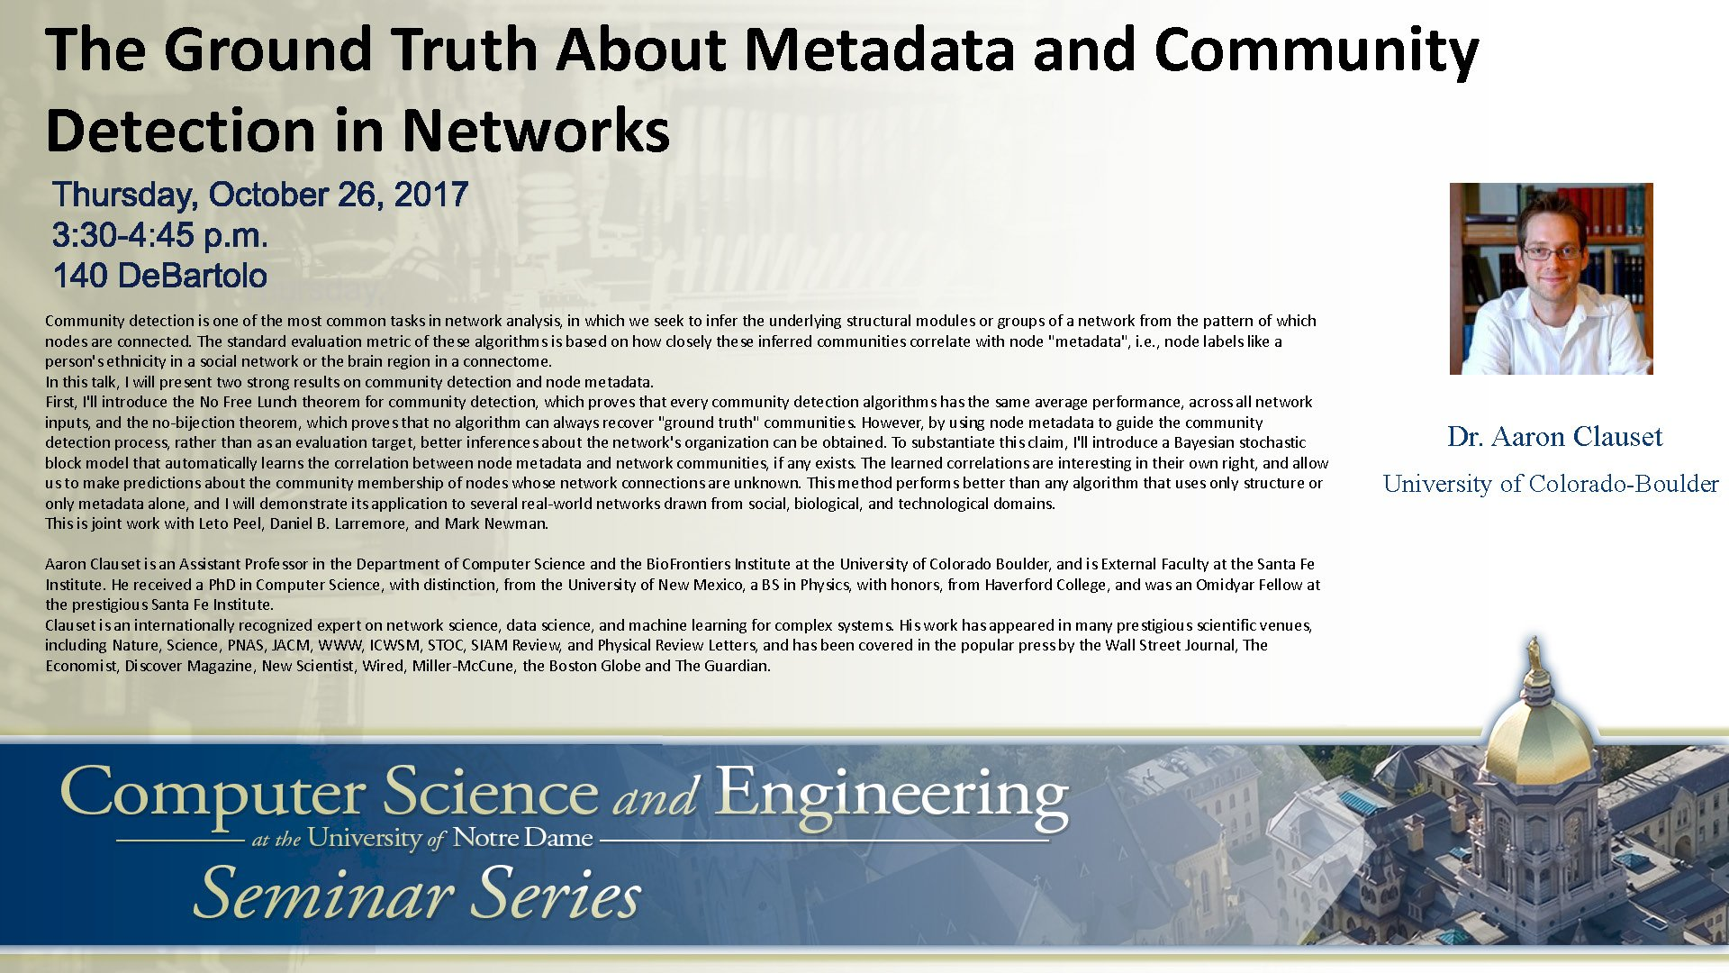

Slide 39
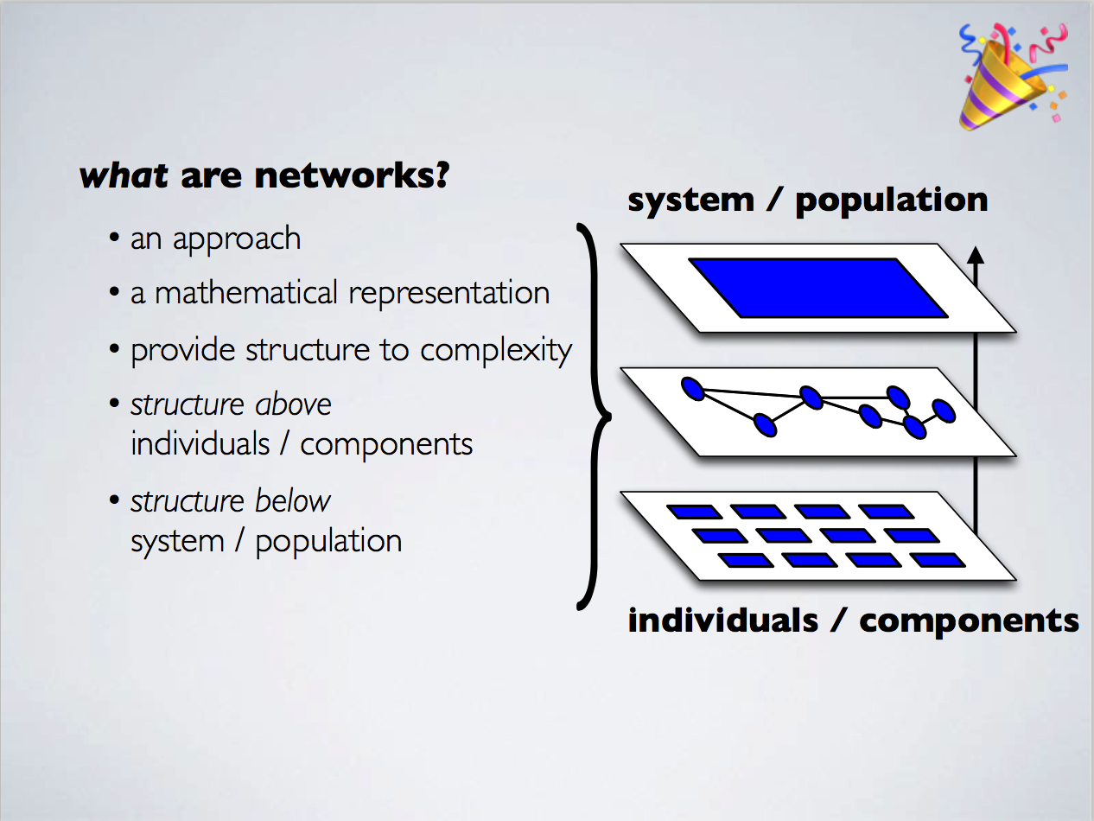

Slide 40
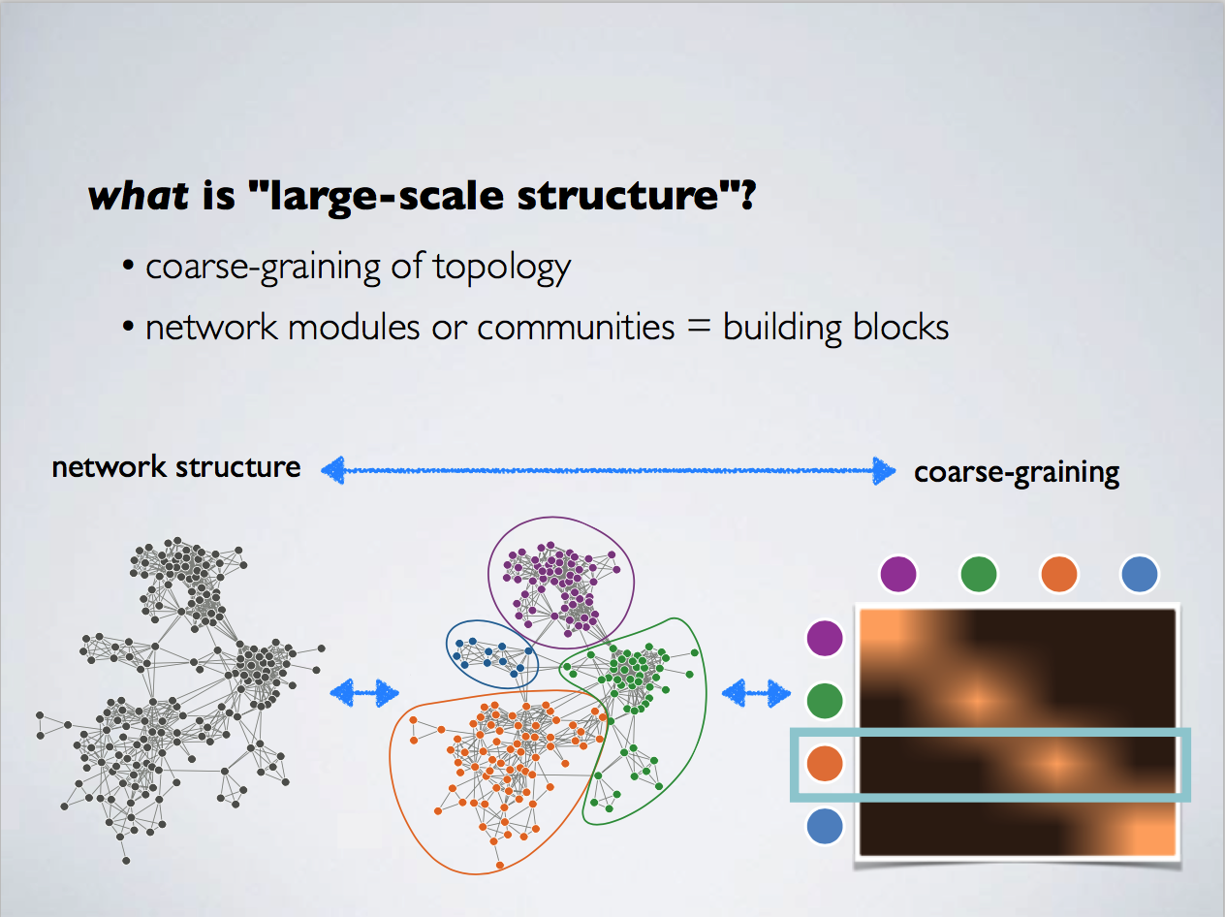

Slide 41
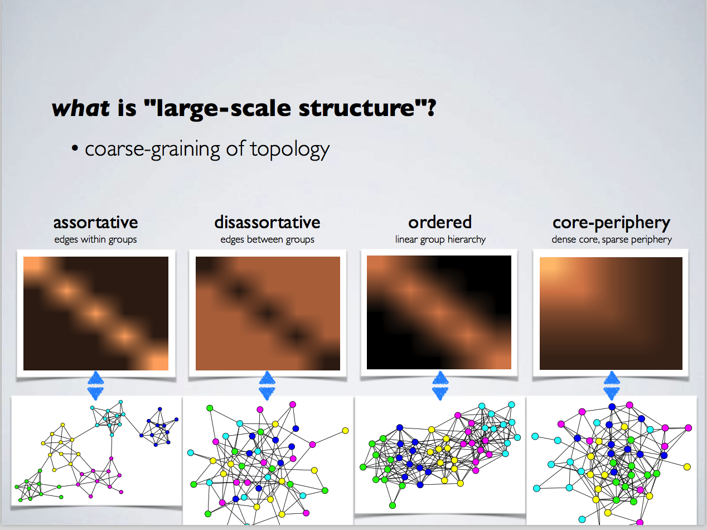

Slide 42
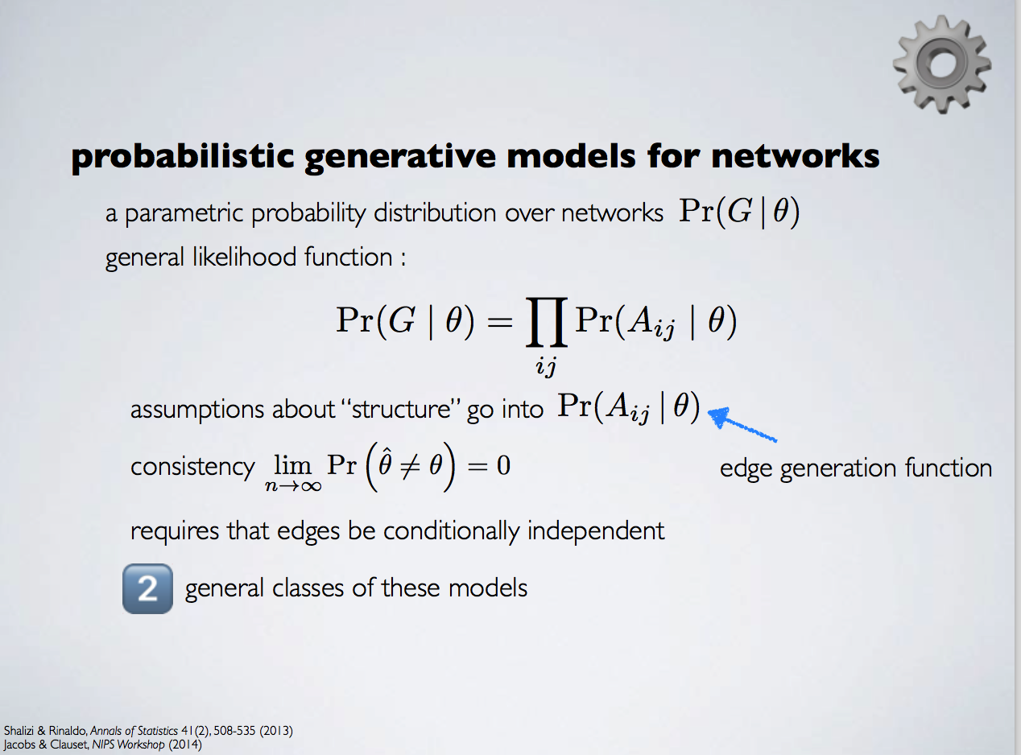

Slide 43
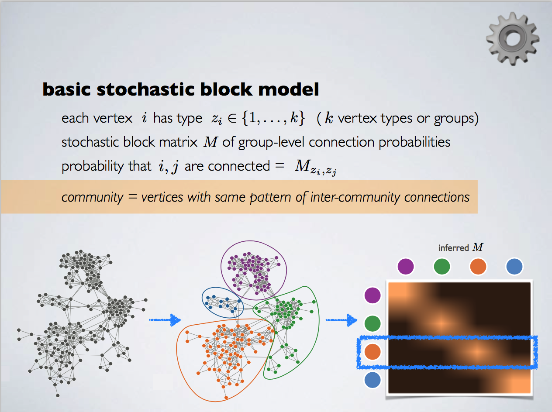

Slide 44
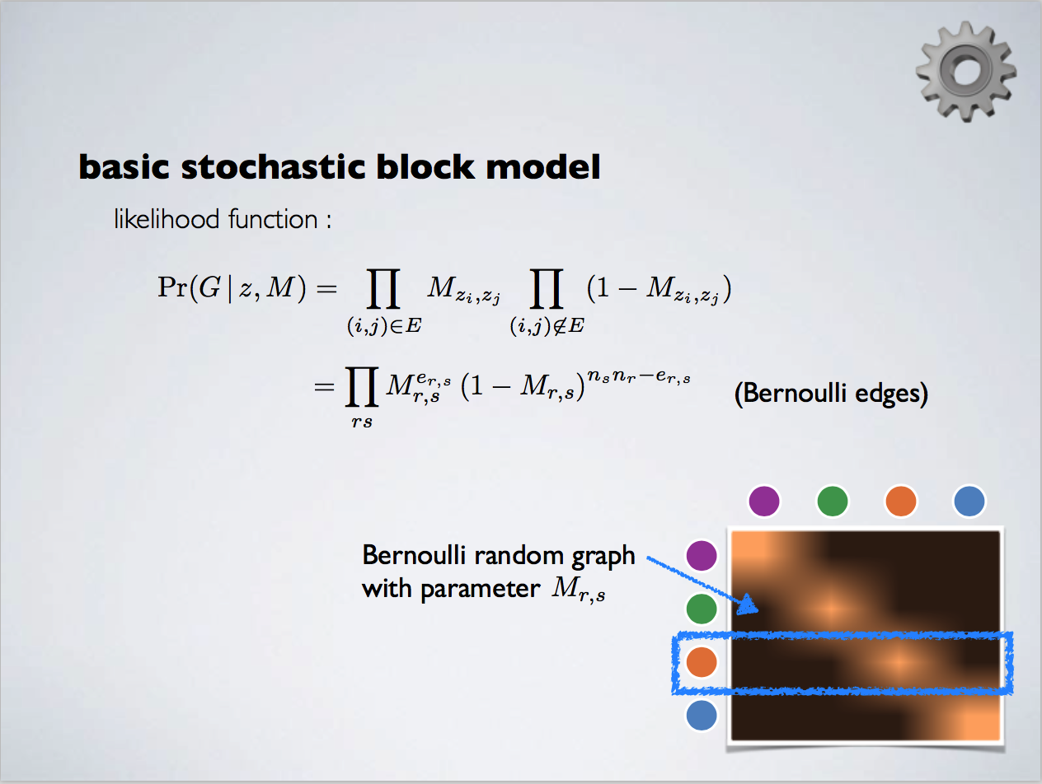

Slide 45
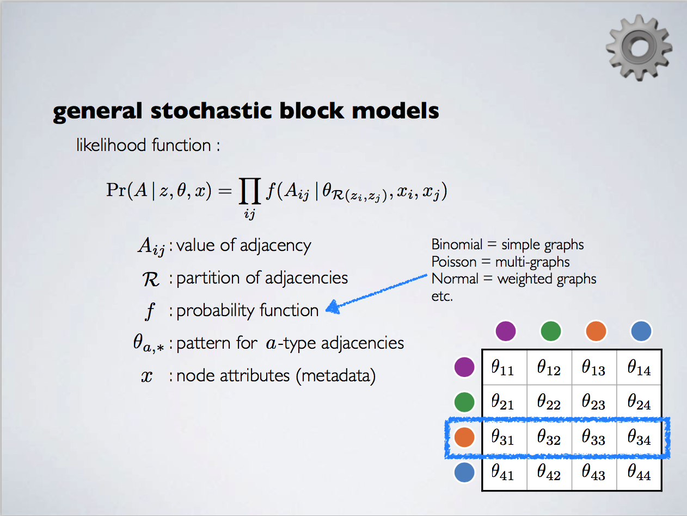

Slide 46
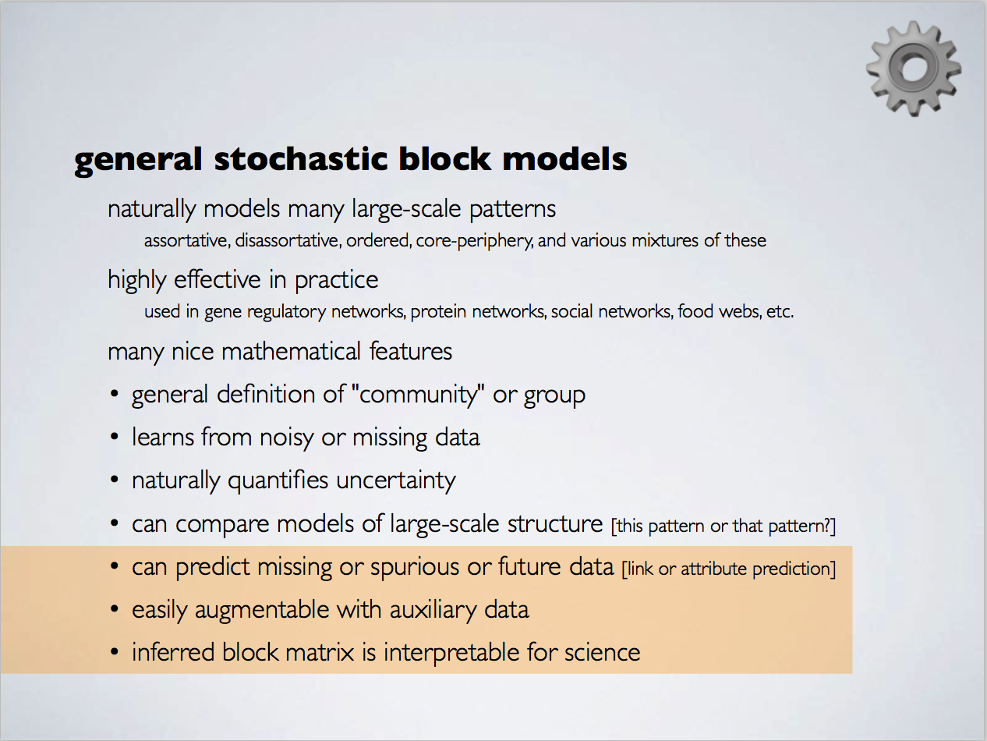

Slide 47
Typical Clustering Methodologies
Distance-based methods
Density-based and grid-based methods
Probabilistic and generative models
Leveraging dimensionality reduction methods
High-dimensional clustering
Scalable techniques for cluster analysis

Slide 48
User Insights and Interactions in Clustering
Visual insights: One picture is worth a thousand words
Human eyes: High-speed processor linking with a rich knowledge-base
A human can provide intuitive insights; HD-eye: visualizing HD clusters
Semi-supervised insights: Passing user’s insights or intention to system
User-seeding: A user provides a number of labeled examples, approximately representing categories of interest
Multi-view and ensemble-based insights
Multi-view clustering: Multiple clusterings represent different perspectives
Multiple clustering results can be ensembled to provide a more robust solution
Validation-based insights: Evaluation of the quality of clusters generated
May use case studies, specific measures, or pre-existing labels

Slide 49
References
Jiawei Han, Micheline Kamber, and Jian Pei. Data Mining: Concepts and Techniques. Morgan Kaufmann, 3rd ed. , 2011 (Chapters 10 & 11)
Charu Aggarwal and Chandran K. Reddy (eds.). Data Clustering: Algorithms and Applications. CRC Press, 2014
Mohammed J. Zaki and Wagner Meira, Jr.. Data Mining and Analysis: Fundamental Concepts and Algorithms. Cambridge University Press, 2014
L. Kaufman and P. J. Rousseeuw, Finding Groups in Data: An Introduction to Cluster Analysis, John Wiley & Sons, 1990
Charu Aggarwal. An Introduction to Clustering Analysis. in Aggarwal and Reddy (eds.). Data Clustering: Algorithms and Applications (Chapter 1). CRC Press, 2014

Slide 50




CATCHTARTAN:
Representing and Summarizing
Dynamic Multicontextual Behaviors
Meng Jiang, Christos Faloutsos, Jiawei Han

Slide 51



What is Tartan?
Visited CMU in 2012-13
Watched lots of
Tartans’ games…

Slide 52
What is Behavior? Is it valuable?
Behavior: interactions made by individuals or organisms in conjunction with themselves or their environment. (Wikipedia)
Tweeting behavior
Publishing-paper behavior
20:03:09 @ebekahwsm
this better be the best halftime show ever in the history of halftimes shows. ever. #SuperBowl
2009 P. Melville, W. Gryc, R. Lawrence, “Sentiment analysis of blogs by combining lexical knowledge with text classification”, KDD’09. Refs: p81623, p84395…
Q: What can we discover from behavioral data?
Ex. Given every phone call / message between the military leaders, scientists, businesspersons, Find …

Slide 53
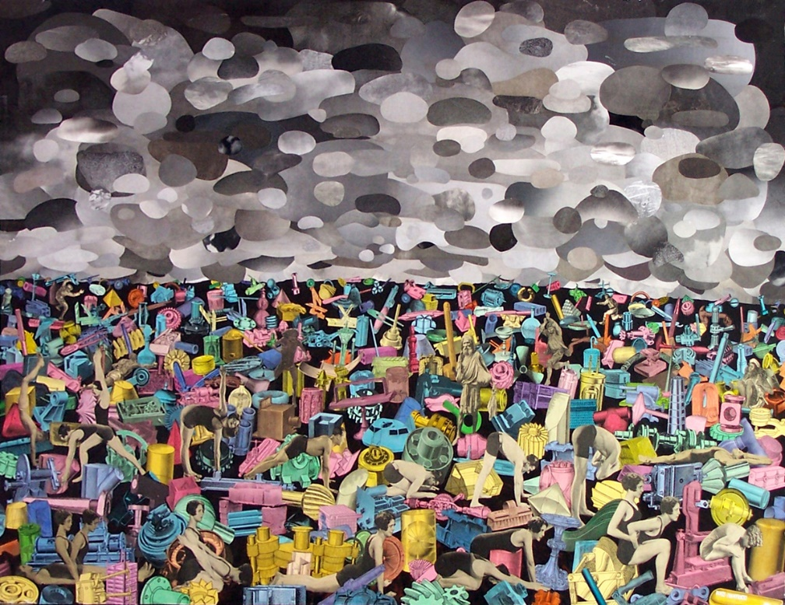
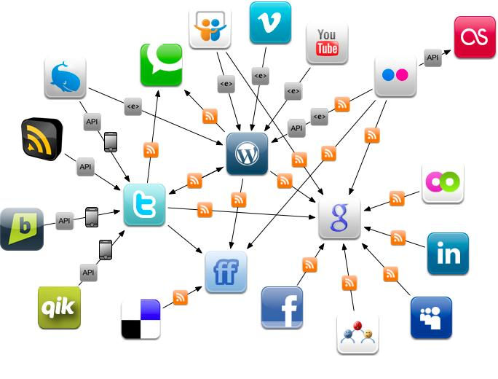
Why We Talk about Behavior Today?
Physical Environment
Online Environment
The human behaviors are broadly and deeply
recorded in an unprecedented level.
This is the first time that we can get insights of human behaviors and the society from large scale real data.

Slide 54
Representing and Summarizing Behavior
Representing
Raw data to Math
Summarizing
Patterns: trends, events, campaigns…
Understanding
Factors underlying the patterns: influence, intentions…
Predicting
What will happen in the future?
Intervening
Recommendation,
spam/fraud detection…

Slide 55
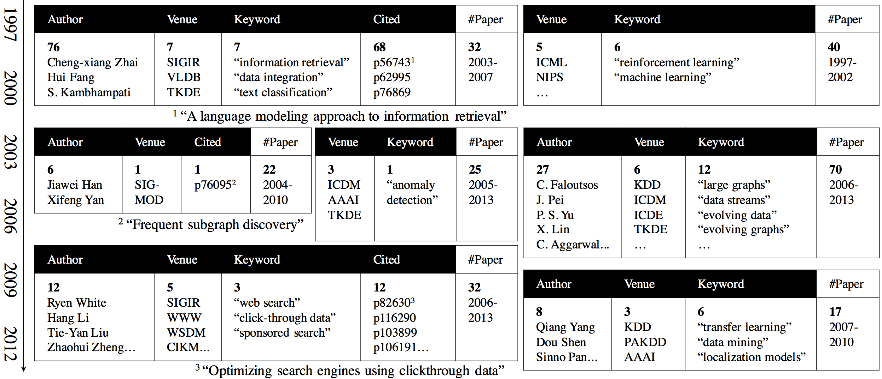
Given the behavioral data (e.g., DBLP data, tweets)
Return behavioral summaries (e.g., research trends, events)
2009 P. Melville, W. Gryc, R. Lawrence, “Sentiment analysis of blogs by combining lexical knowledge with text classification”, KDD’09. Refs: p81623, p84395…

Slide 56
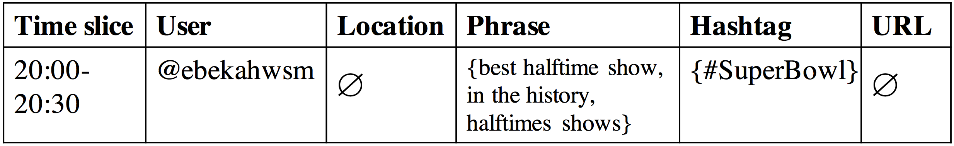
Behaviors: Dynamic and Multicontextual
Tweeting behavior
20:03:09 @ebekahwsm
this better be the best halftime show ever in the history of halftimes shows. ever. #SuperBowl
Contextual factors:
t
u
p
h
p
p
One-guaranteed
value
Empty (set
of) value
Empty (set
of) value
Set value
Dynamic

Slide 57
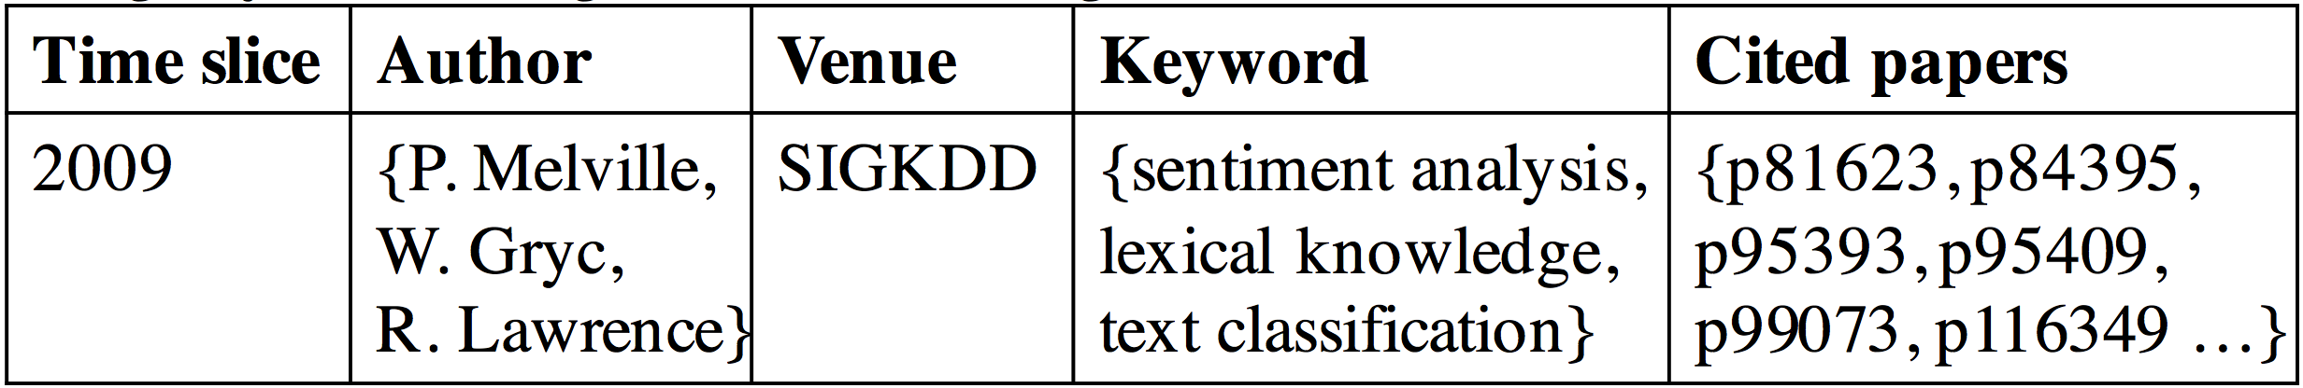
Behaviors: Dynamic and Multicontextual
2009 P. Melville, W. Gryc, R. Lawrence, “Sentiment analysis of blogs by combining lexical knowledge with text classification”, KDD’09. Refs: p81623, p84395…
Publishing-paper behavior
Contextual factors:
t
c
a
c
One-guaranteed
value
a
a
v
p
p
p
Set value
Set value
Set value
Dynamic

Slide 58
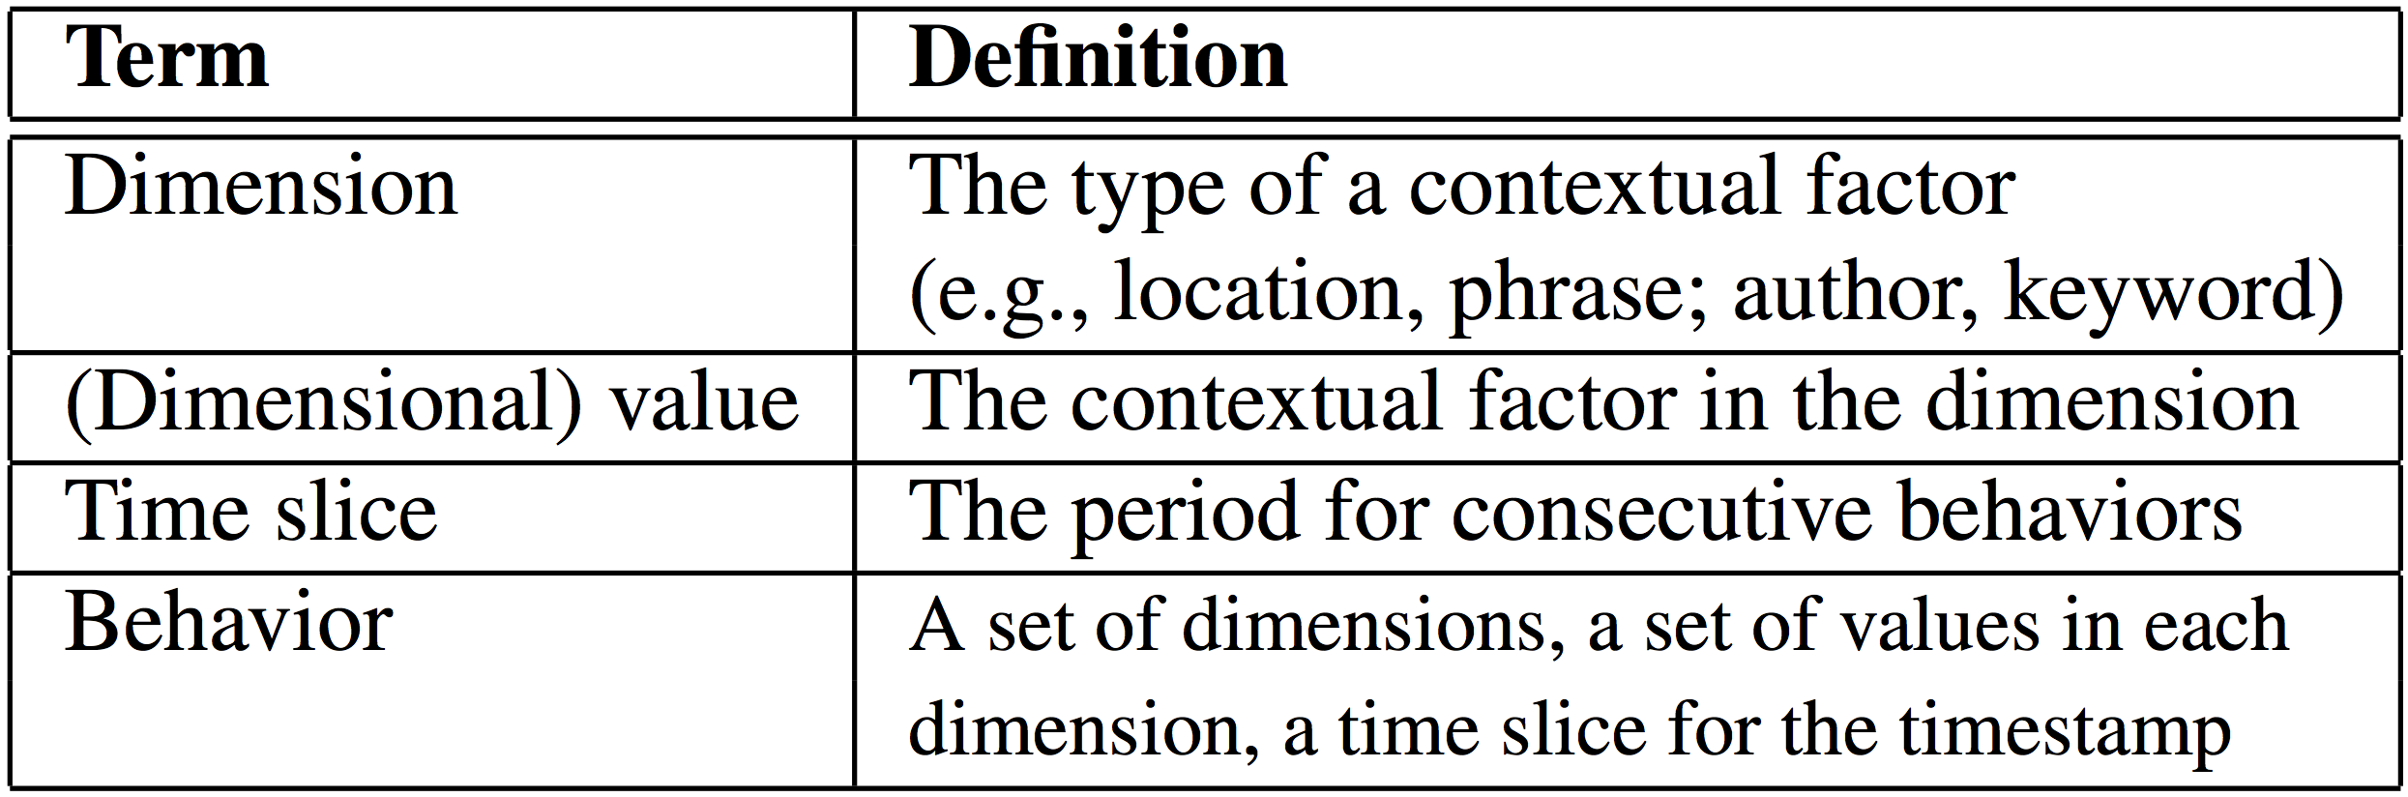
Summarizing Behaviors
Dynamic: taking a set of consecutive time slices
Multicontextual: taking a set of dimensions and a set of dimensional values in each dimension

Slide 59
Tensor Fails
Tensor - modeling multidimensions: FEMA (KDD’14), CrossSpot (ICDM’15)
Representation: (multicontextual)
Empty values?
∅
http://XXX.YYY
only $3.99
∅
Bob
∅

Slide 60
Tensor Fails (cont.)
Tensor - modeling multidimensions: FEMA (KDD’14), CrossSpot (ICDM’15)
Summarization: (dynamic)
Temporal patterns?
t₁₀
t₁₁
t₂₄
t₂₅
t₂₆
t₃₁
t₃₇
http://XXX.YYY
only $3.99
Bob

Slide 61
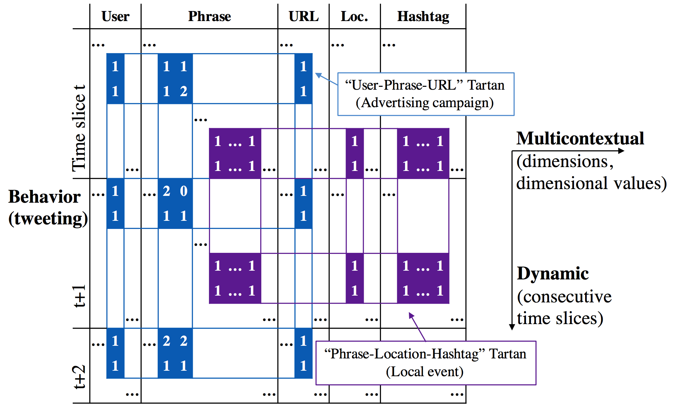
Our Representations for Behavior and Behavioral Summary
Behavior: “Two-level matrix”
Behavioral summary: “Tartan”

Slide 62
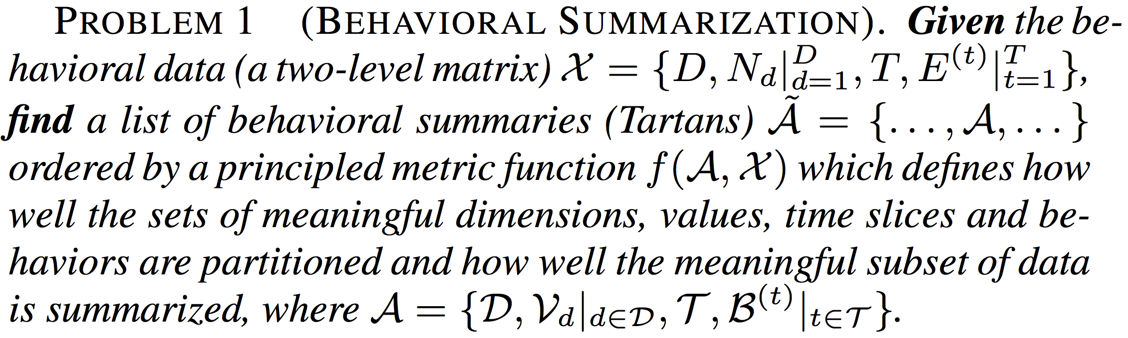
The Problem of Behavioral Summarization

Slide 63
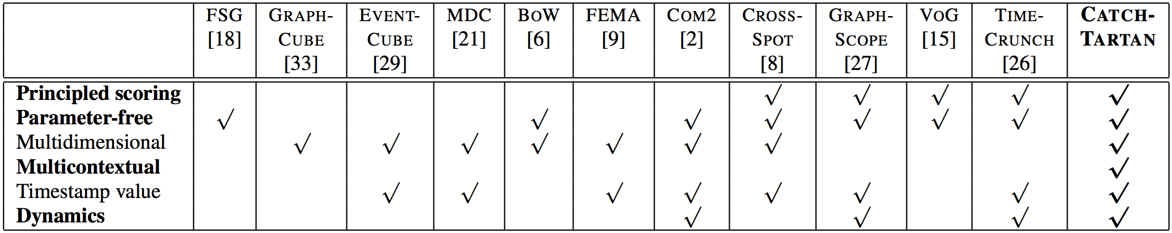
CATCHTARTAN
Employing a lossless encoding scheme
The Minimum Description Length (MDL) principle
Estimating the number of bits that encoding the Tartan can save from merging the meaningful pattern into the encoding of the data

Slide 64
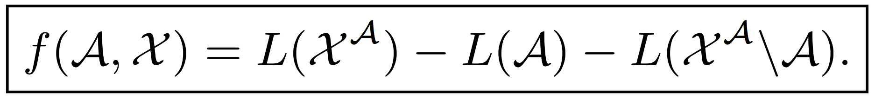
Objective Function to Maximize
Tartan
Data
First-level matrix
Individual entries

Slide 65
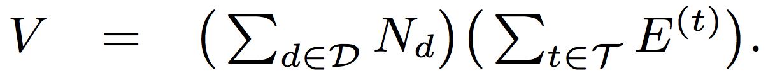
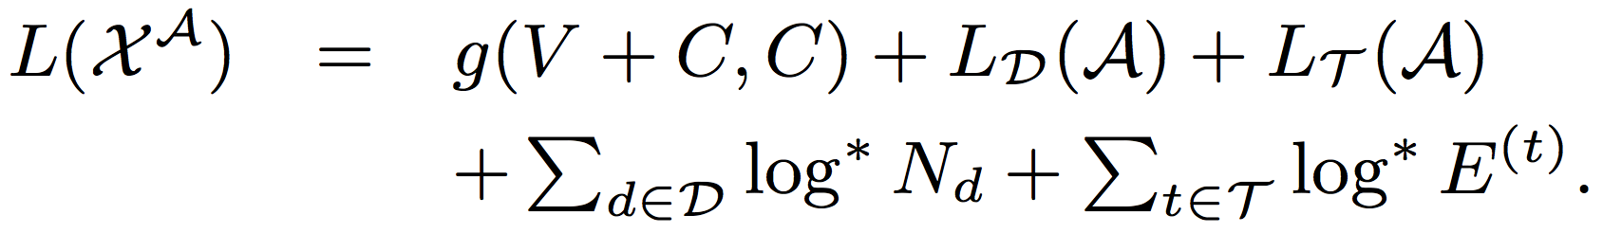
Objective Function to Maximize (cont.)

Slide 66
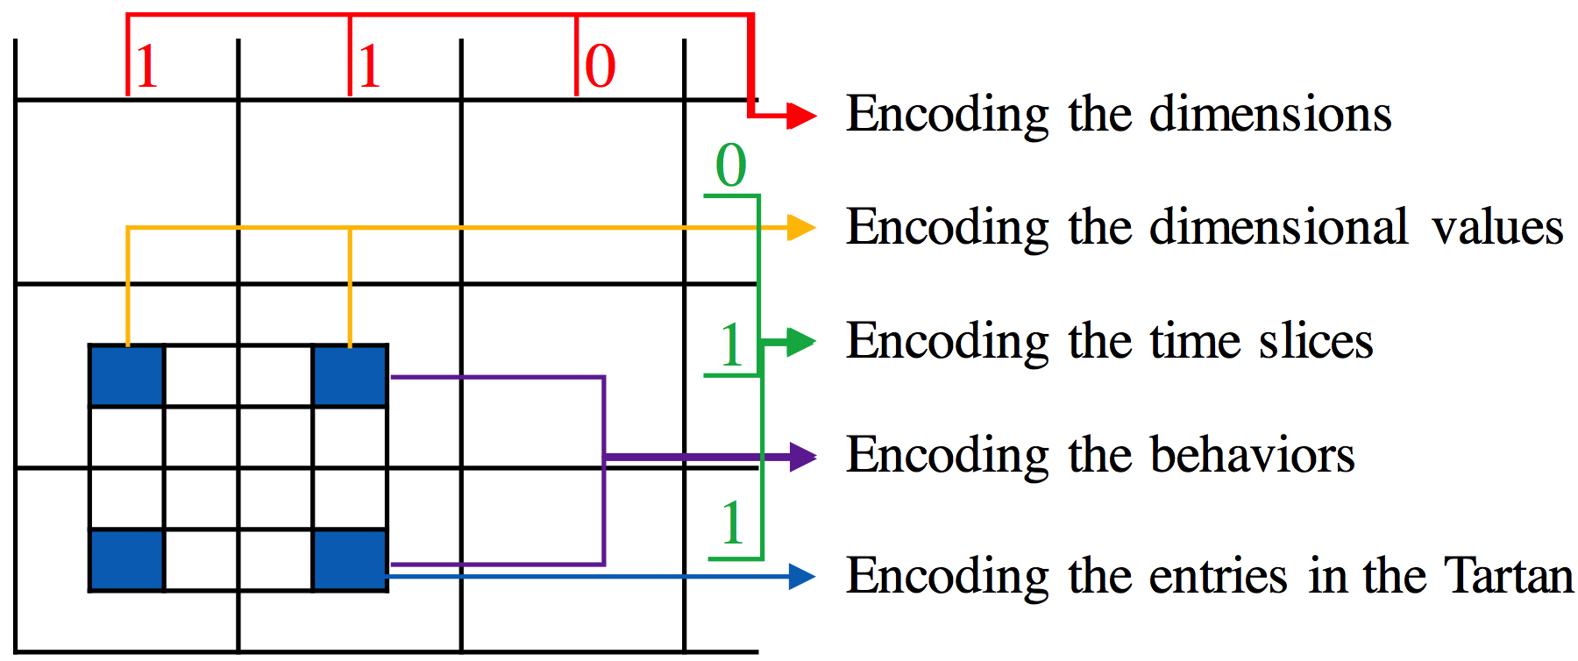
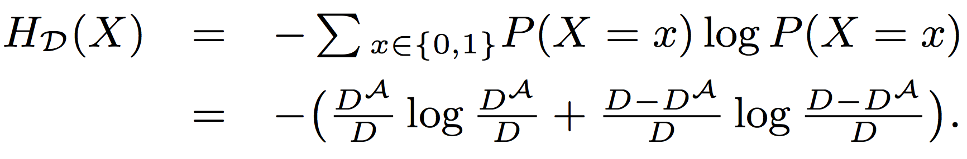
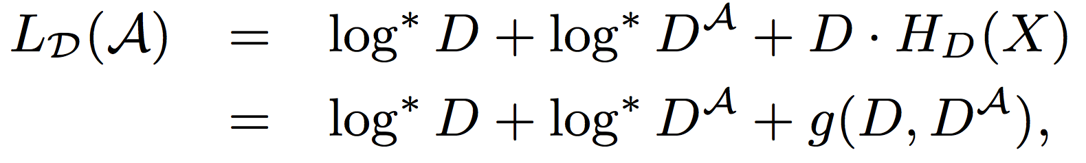
Encoding the Tartan: Dimensions

Slide 67
Encoding the Tartan: Dimensional Values

Slide 68
Encoding the Tartan: Time Slices

Slide 69
Encoding the Tartan: Behaviors

Slide 70
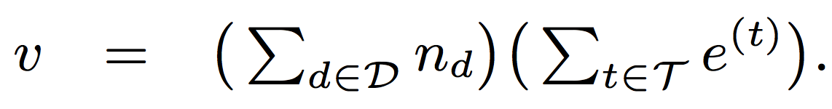
Encoding the Tartan: Entries

Slide 71
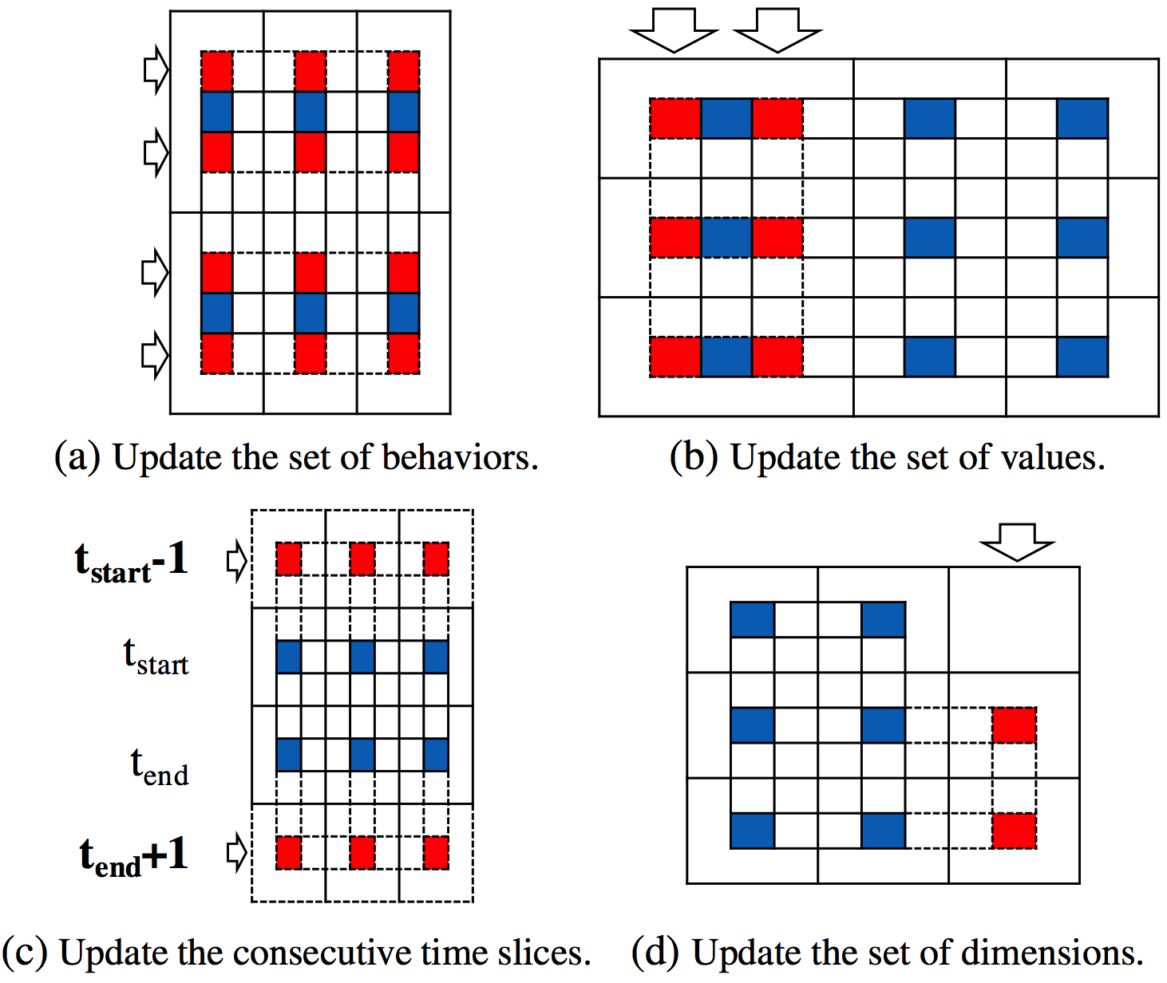
Greedy Search for the Local Minimum
Time complexity:

Slide 72
Qualitative Analysis: DBLP data

Slide 73
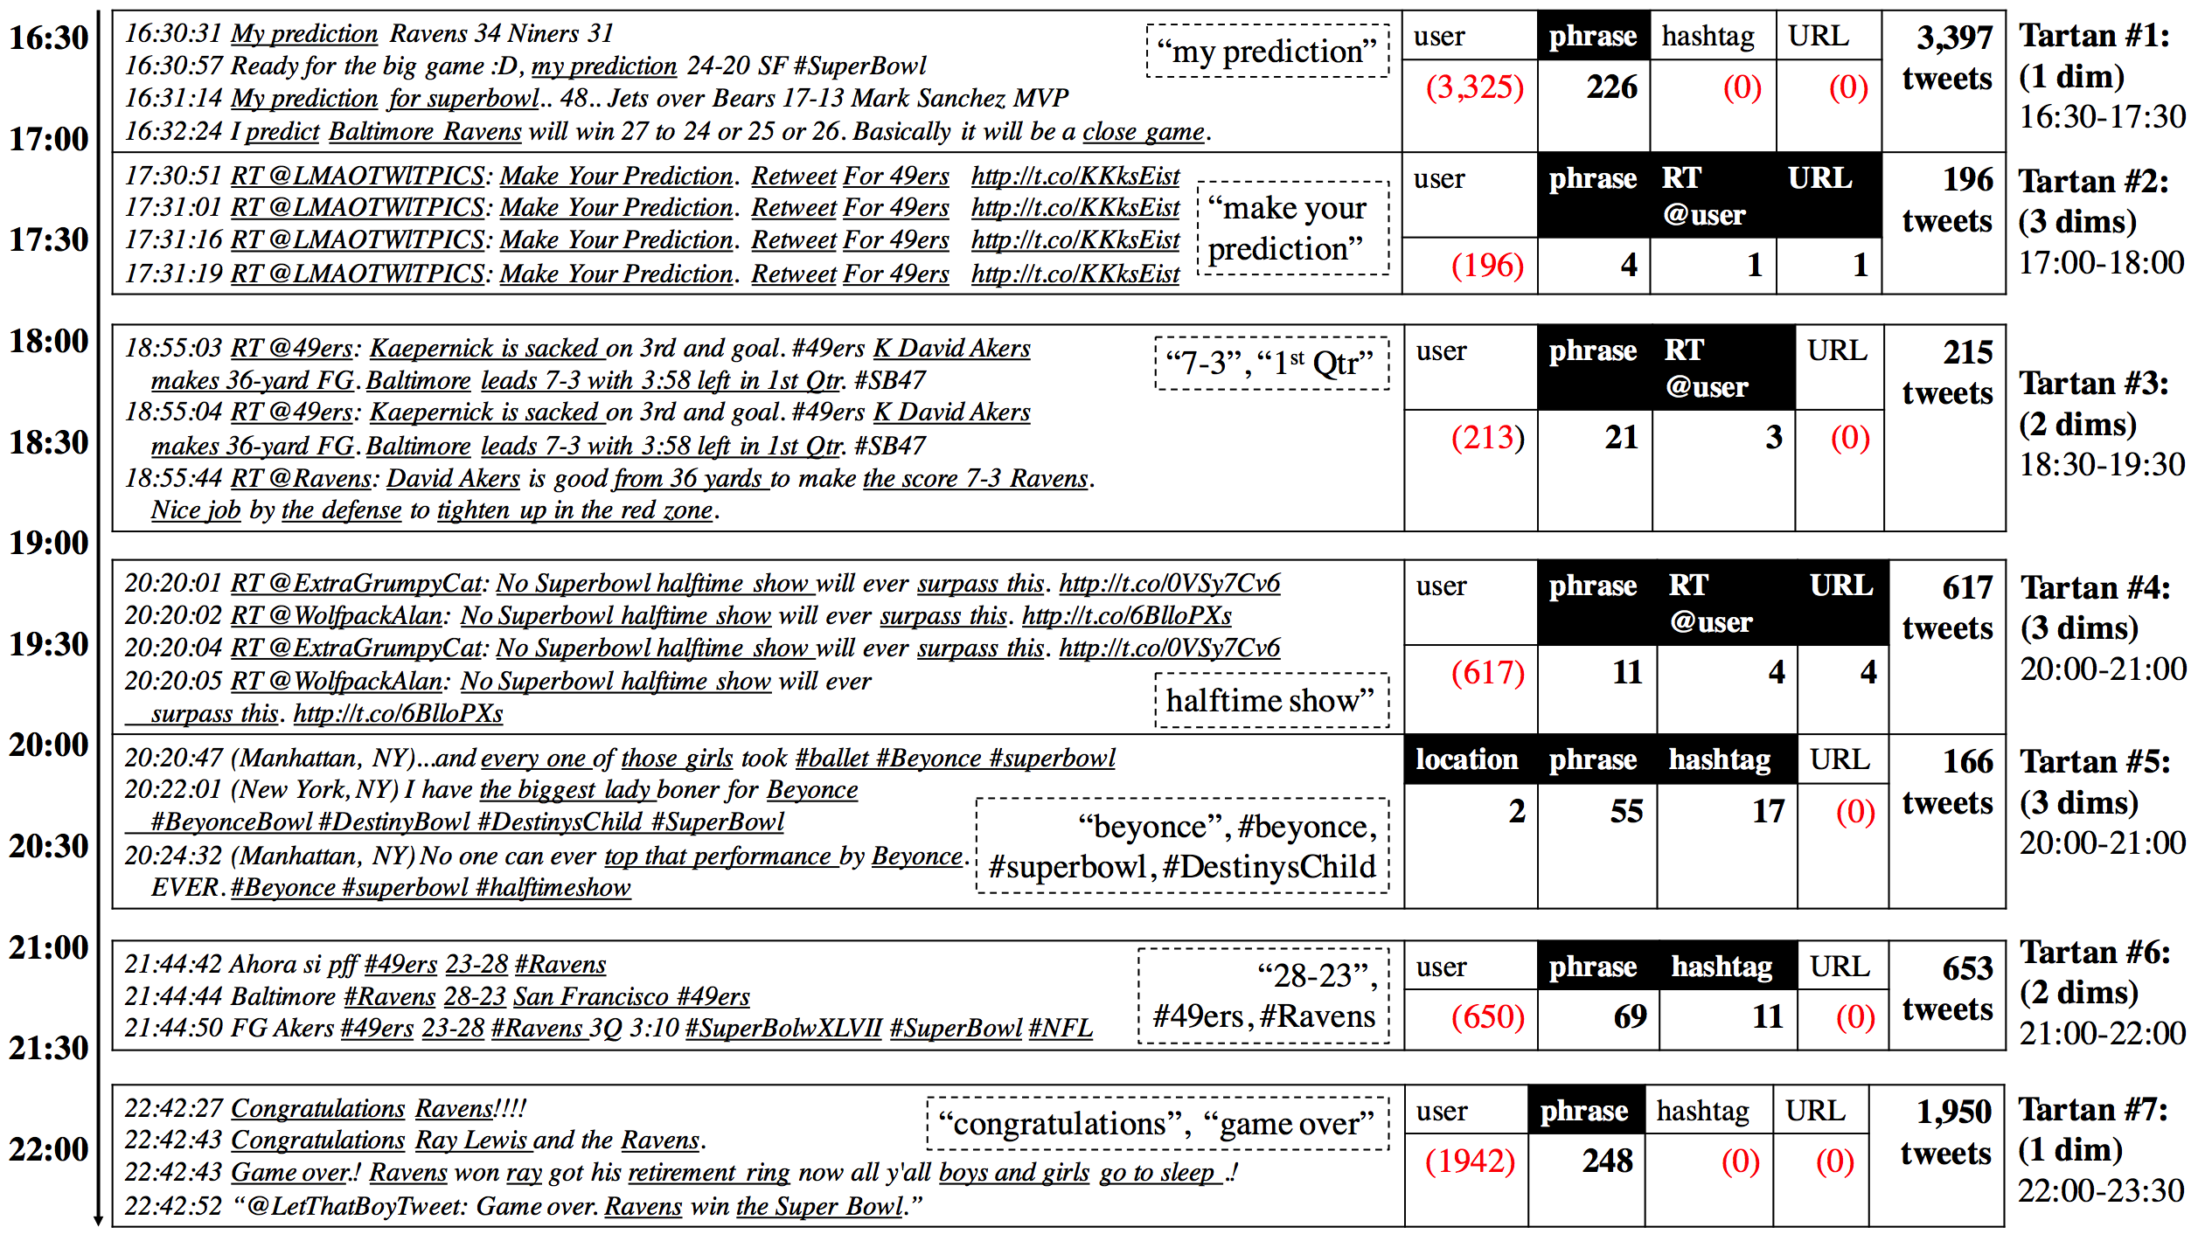
Qualitative Analysis: Super Bowl 2013

Slide 74
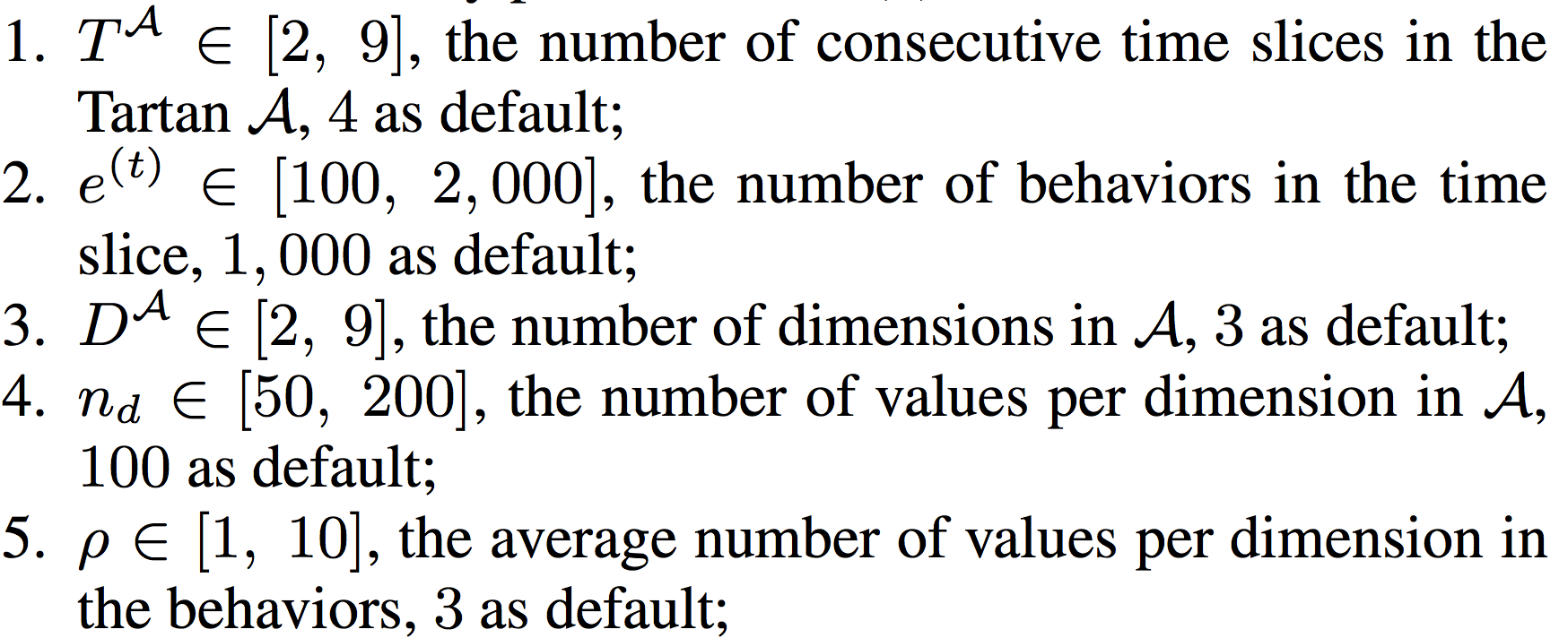
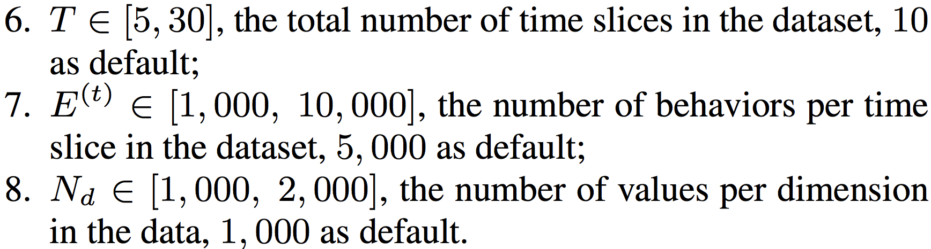
Quantitative Analysis: Accuracy and Efficiency in Synthetic Experiments
Tartan distribution
Data distribution

Slide 75
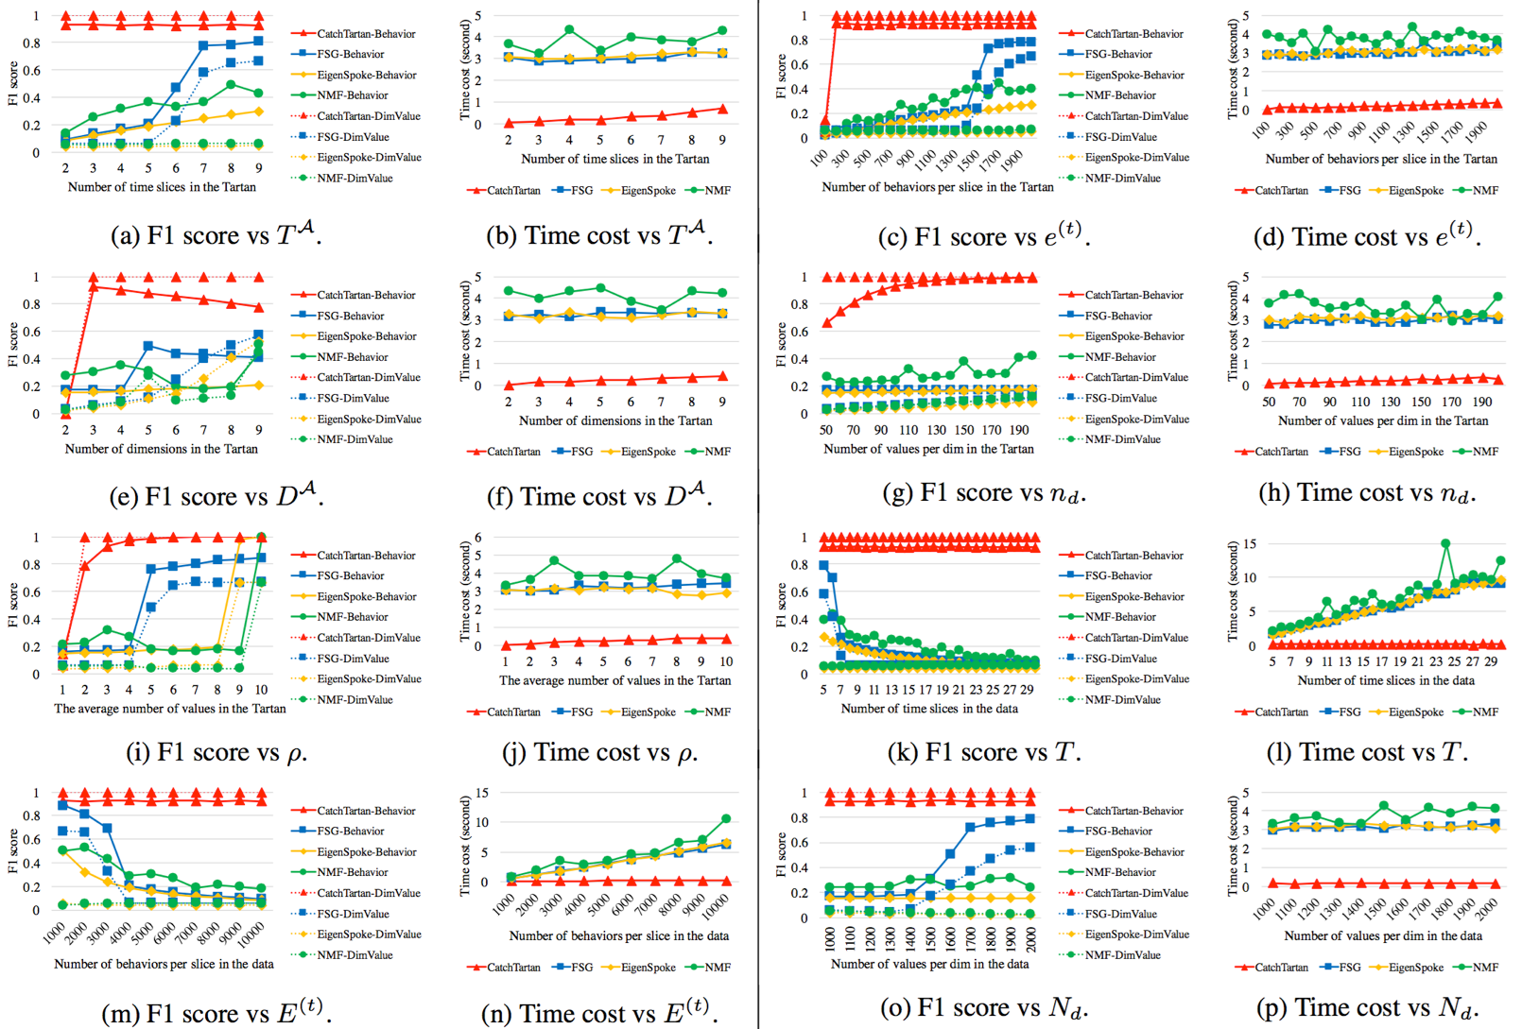

Slide 76
Summary
Novel representations
Behavior: “two-level matrix” vs. tensor
Behavioral summary: “Tartan” vs. dense block
A new summarization algorithm
Principled-scoring and Parameter-free: Objective function based on Minimum Description Length
Scalable: Greedy search for local optimum
Effectiveness, discovery and efficiency

